Slide 1
Navigating Uncertainty
The EP Election's Impact on Economic Policy, Security, and Growth
Manuela Moschella
Department of Political and Social Sciences

Slide 2
Focus
Direction of EU economic policies in light of EP election results and confirmation of Ursula von der Leyen as President of the European Commission

Slide 3
Message
It’s difficult to make predictions, especially about the future!
Main reason: unpredictability, which lies both in economics but especially in politics

Slide 4
Why the unpredictability
Economic unpredictability: Growth and competitiveness, inflation, structural shifts and geopolitics
Political unpredictability: Varied stances across political groups and countries, including within those that are supporting the work of the new Commission

Slide 5
Three economic policy agendas
The agenda for economic growth—particularly sustainable and green growth: How much to intervene?
The agenda for economic security: How much autonomy from the rest of the world?
The financing agenda: How will the EU finance its ambitions? More or less Europe

Slide 6
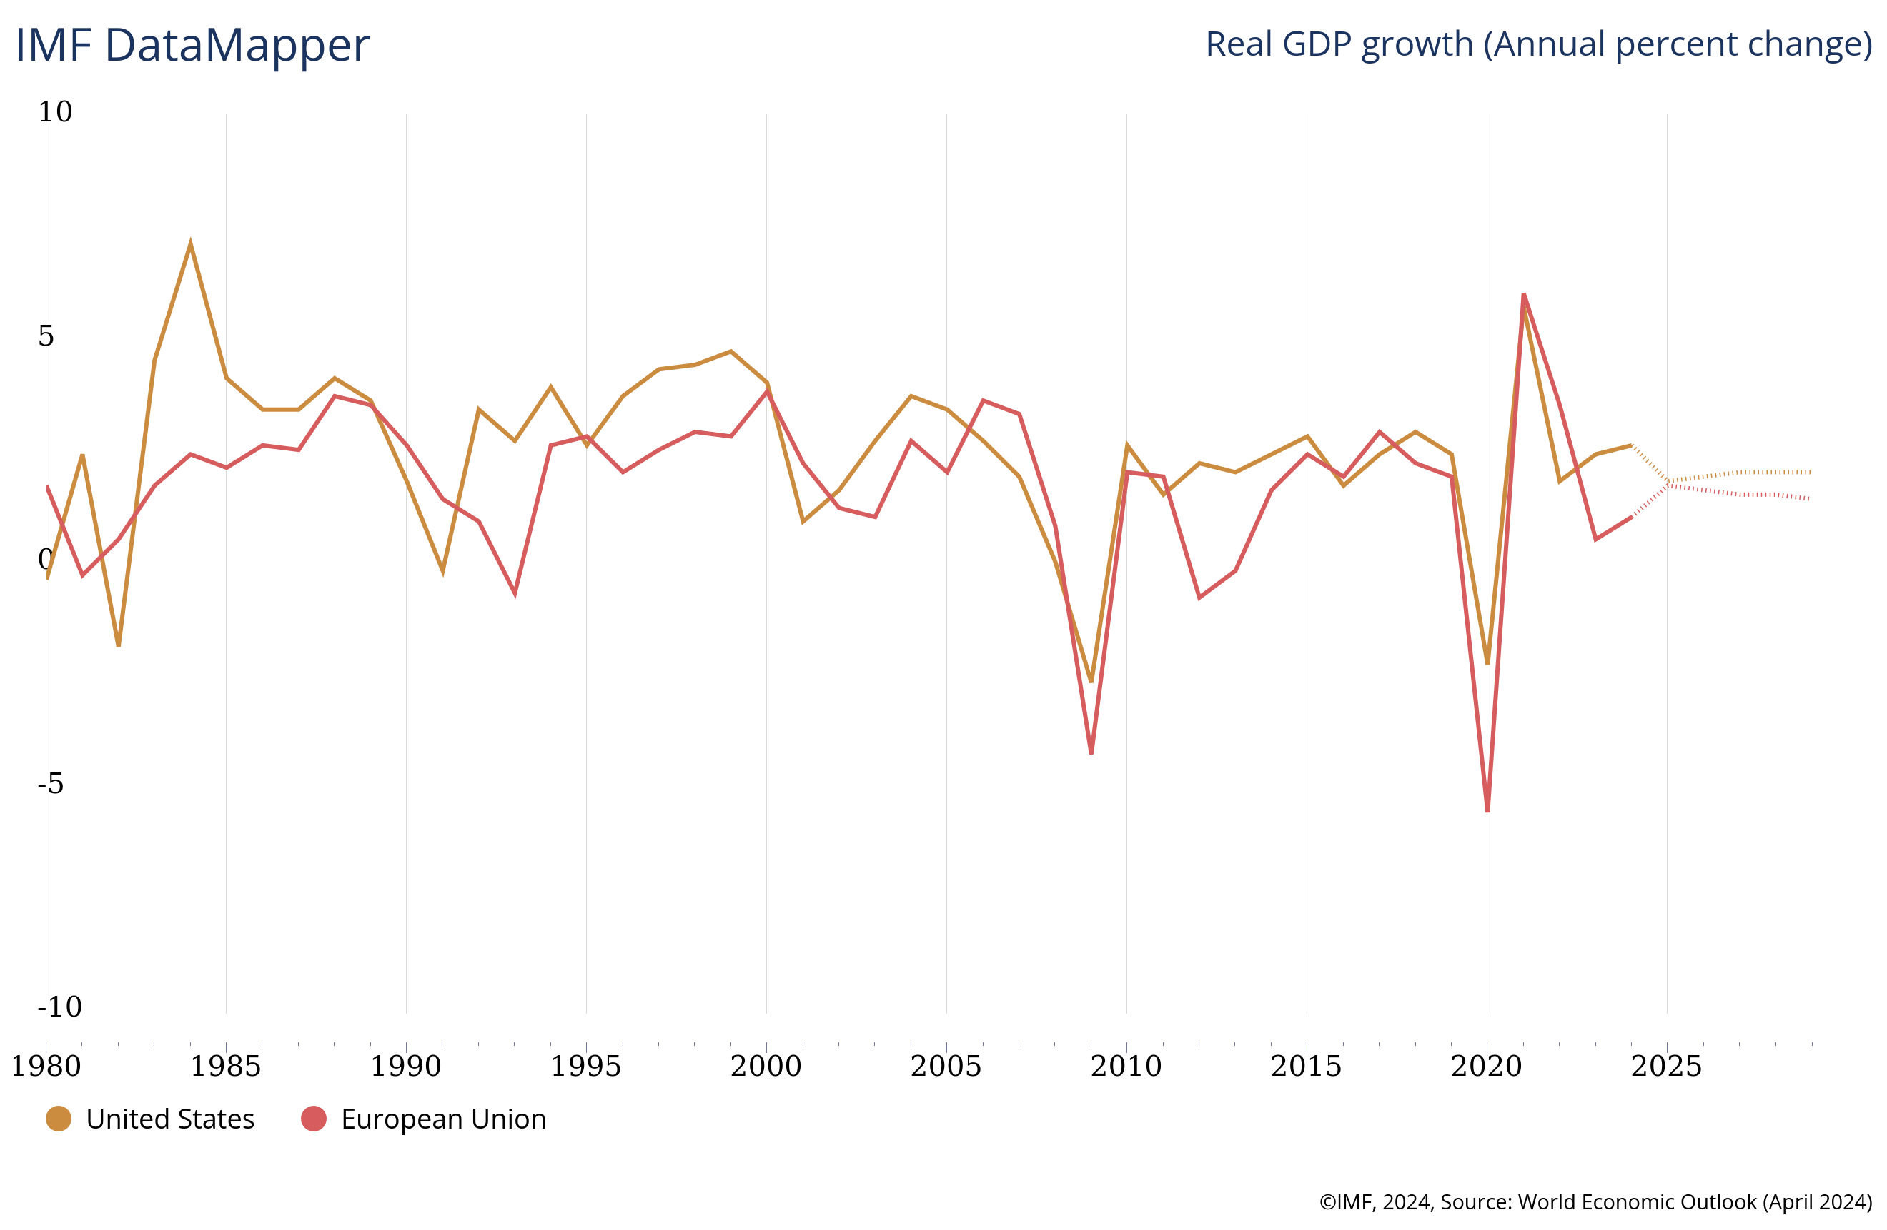
1. Economic growth agenda

Slide 7
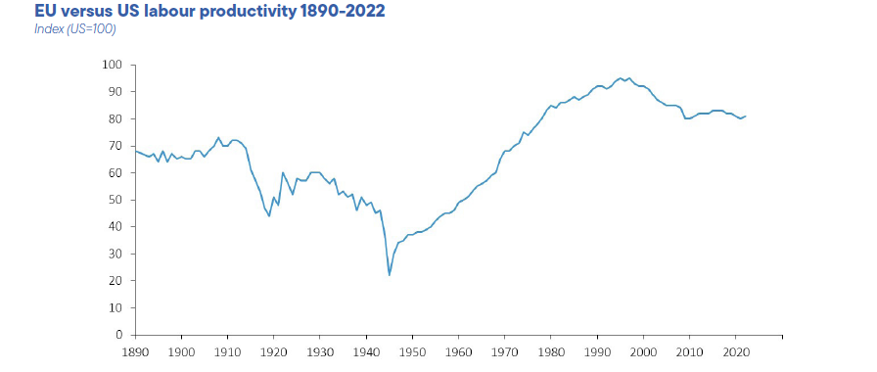
Source: Draghi report (2024)

Slide 8
Furthermore
Structural shifts: green transition, technology
Geopolitical shifts
Policy shifts and global spillovers
With all of them taking place simultaneously with implication for trade and financial globalization (from which the EU has benefitted)

Slide 9
Not just economics…. variegated political views
Political divisions on how to tackle those economic challenges – at least based on electoral campaign pledges and early moves
Centre-right and Liberals (market-friendly) vs. Socialists and Greens (investment, regulation)
Populists’ split

Slide 10
Centre-Right and Liberals Approach
Strengthening the Single Market
Deepening Capital Market Union
Reluctance to push for large public investments (post-NGEU)

Slide 11
Socialists and Greens Approach
Call for a new Social Pact
Push for common debt and a revised Stability and Growth Pact
Green agenda: AI regulation, sustainable investments, ECB secondary mandate

Slide 12
Populists: Economic Sovereignty, but What Kind?
Common ground: Sovereignty at the national level, not the EU level
Internal divides:
Northern parties (e.g, AfD): No debt mutualization, fiscal discipline
Southern parties (e.g., Brothers of Italy): Looser fiscal rules, common EU resources

Slide 13
2. Economic security agenda
From COVID and disruptions of global value chains to US-China competition
EU responses thus far:
Open stategic autonomy
New industrial policy, not just through competition law

Slide 14
Walking on a tightrope
Divisions (across countries) and balancing acts – example EU approach to China
China strategy: From decoupling to derisking
EU tariffs on Chinese electric vehicles (opposition from Germany)

Slide 15
Problems across ideological lines
Deciding on how much autonomy is going to be a headache for the main political groups in virtue of the values that EU has tarditionally embraced: and open, liberal, multilateral global economic system
The question of autonomy will also complicate the debate on the populist front: think about the prospects of Trump election

Slide 16
3. The financing agenda
Propping up growth and competitiveness as well as developing an economic security agenda is not “a free lunch”
Just in terms of green transition, the expectation is in the order €500-700 billion per year

Slide 17
Where to get the money from?
Traditional question in the EU (that gets at the heart of EU economic and political integration) and ties with the issue of solidarity
There is also a corollary question: how to mobilize private money

Slide 18
Centre-right split (at least, during the electoral campaign)
EPP distancing from NGEU-style investments
RENEW proposing a Sovereignty Fund (Macron’s influence)
Centre-right – Centre-left split
Populists are split as well: more or less Europe …taking back control at the national level?

Slide 19
Conclusions
“Europe now faces a clear choice. A choice which will shape our work for 5 years and define our place in the world for the next 50. The choice comes down to whether we will be shaped by events and the world around us or whether we will come together and build our future for ourselves” Ursula Von Der Leyen Statement at the European Parliament Plenary, 2024
Enormous challenges along with significant divisions along political and country lines
At least one prediction can be made: it’s not going to be boring!

